Slide 1
LaunchPad AI
Turning Overwhelm Into Action, One Step at a Time
Microsoft Agents League Hackathon Reasoning Agents Track
Created by: Robert Couch

Slide 2
Mission
Problem: Millions of people struggle to start and complete important goals because of overwhelm, task initiation challenges, and executive function barriers.
Solution: Launchpad AI helps users move from intention to action through AI-guided planning, focus coaching, and progress recovery

Slide 3
The Problem
The Executive Function Gap
Many productivity tools help users organize work.
Few help users begin.
Common barriers include:
• Overwhelm • Procrastination • Analysis paralysis • Unclear starting points • Perfectionism • Difficulty resuming after interruptions
Example:
"I need to study for Security+, but I don't know where to start."
The challenge isn't knowledge.
The challenge is execution.

Slide 4
Solution, Architecture, Technology, Demo, and Future Vision
Solution
Launchpad AI is an executive-function support agent that helps users:
Identify barriers
Clarify goals
Break work into milestones
Start focused work sessions
Recover progress after interruptions

Slide 5
Workflow
User Goal ↓ Barrier Detection ↓ Planning ↓ Focus Coaching ↓ Progress Recovery

Slide 6
Agent Architecture
Current MVP uses a single Azure AI Foundry agent implementing specialized reasoning roles:
• Executive Function Agent • Learning Path Agent • Study Plan Agent • Focus Coach Agent • Progress Recovery Agent
Future versions can separate these into independently orchestrated agents.

Slide 7
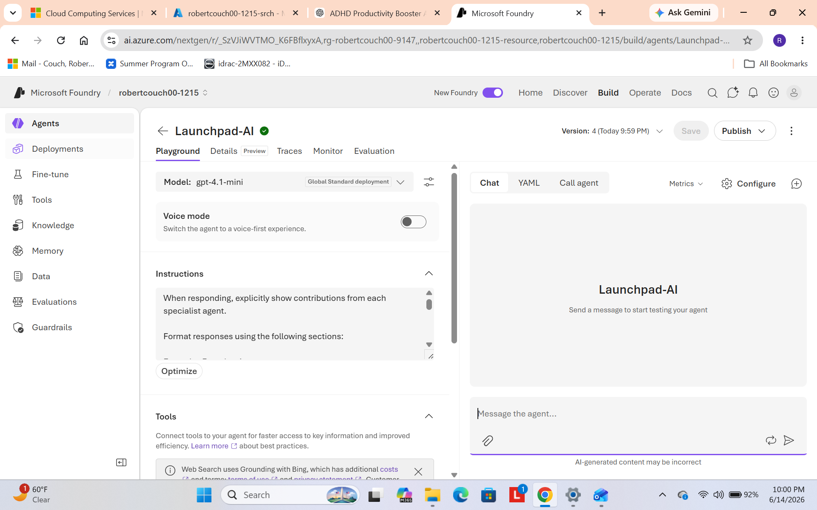
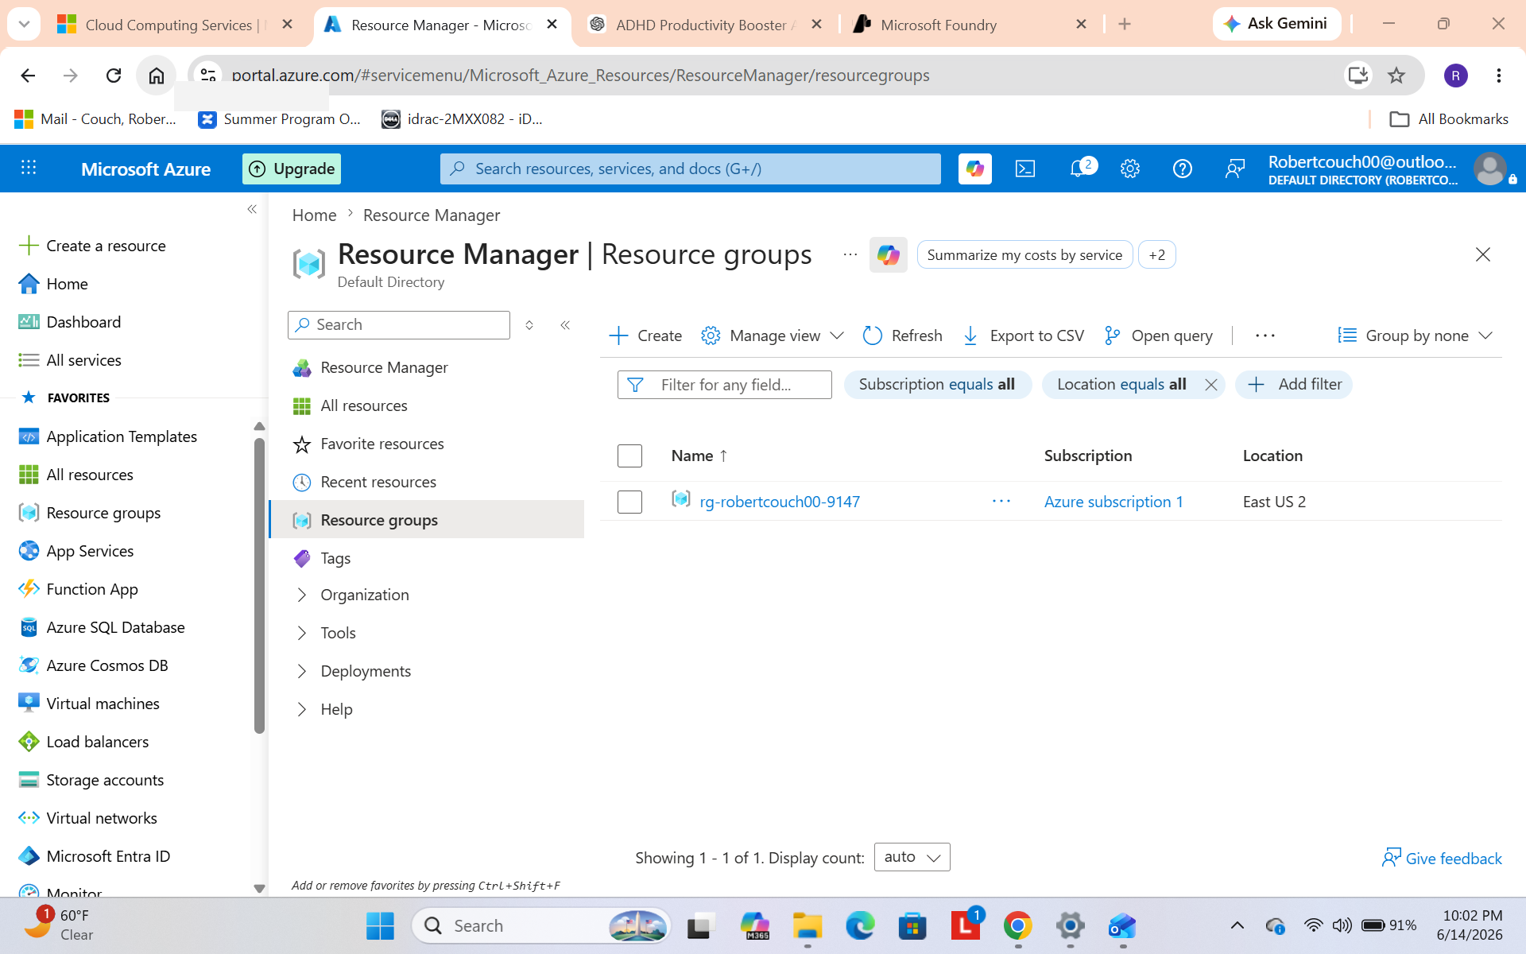
Microsoft Technology Stack
Built using:
• Azure AI Foundry • GPT-4.1-mini • Azure AI Search • Foundry Knowledge Base • Foundry IQ Knowledge Retrieval
Knowledge Sources:
• Executive Function Guide • Security+ Study Guide

Slide 8
Demo Scenario
User Input:
"I need to study for Security+ but I keep getting overwhelmed. I don't know where to start and I keep putting it off."
Launchpad AI:
• Identifies overwhelm as the primary barrier • Breaks Security+ into milestones • Recommends a 15-minute focus session • Provides the smallest actionable next step • Creates a progress summary for later recovery
Additional test:
"I want to clean my apartment but feel overwhelmed."
Result:
The same workflow successfully generalized beyond studying, demonstrating applicability across work, learning, and personal goals.

Slide 9
Future Vision
Launchpad AI can support:
• Certifications • College courses • Work projects • Job applications • Homelab projects • Household organization • Personal development goals
Long-term goal:
Create a true multi-agent executive-function platform that helps people consistently transform intentions into meaningful progress.

